Slide 1
Integrating Alma with a financial system to export import and pay invoices
Yoel Kortick
Senior Librarian

Slide 2

Agenda
Introduction
The settings
The integration profile
The invoice is created and ready to be paid
Invoice is exported to the finance system
Payment status imported from Finance System invoice closed

Slide 3
Introduction

Slide 4
Introduction
This document will explain the steps in exporting invoices to the financial system and then updating Alma from the financial system when the invoice is paid.
This document will not discuss the creation of the invoices. It will begin after the invoice has been created and before it is exported to and synchronized with the financial system.
For information about creating invoices see the Online Help here.

Slide 5
Introduction
In addition to this document, it is highly recommended to see the developer network.
Also of interest is the blog by Nathan Mealey of Portland State University titled “Exporting Invoices and Importing Payments with Banner and Alma”.

Slide 6
The settings

Slide 7
The settings
In the workflow described here the following settings exist in the institution. The settings are found under the acquisitions configuration menu in “General > Other Settings” and will also be explained in the following slides.

Slide 8
The settings
handle_invoice_payment = true
This means that invoices are sent to the ‘Waiting for Payment Invoices’ page to await automatic or manual handling. The page is accessed at Acquisitions > Receiving and Invoicing > Waiting for Payment
If this parameter was set to false, then invoices would be closed automatically when they are exported to the ERP system.

Slide 9
The settings
invoice_skip_erp = false
This means that the invoice workflow does not skip the step where the invoice is Waiting for Payment

Slide 10
The settings
invoice_use_pro_rata = true
This means that the use pro rata setting is selected by default when creating new invoices. See here for more information about the pro rata when invoicing.

Slide 11
The integration profile

Slide 12
The integration profile
An integration profile of type finance should be created. See here for more about this type of integration profile.
Via this integration profile the invoices will be exported to the financial system and imported back from the financial system with payment status.
As with other integration profiles the invoices are not sent directly back and forth to the “other system” but rather placed on an ftp server for “pickup”.
The integration profile is created via “External systems > Integration Profiles” under the General Configuration menu.

Slide 13
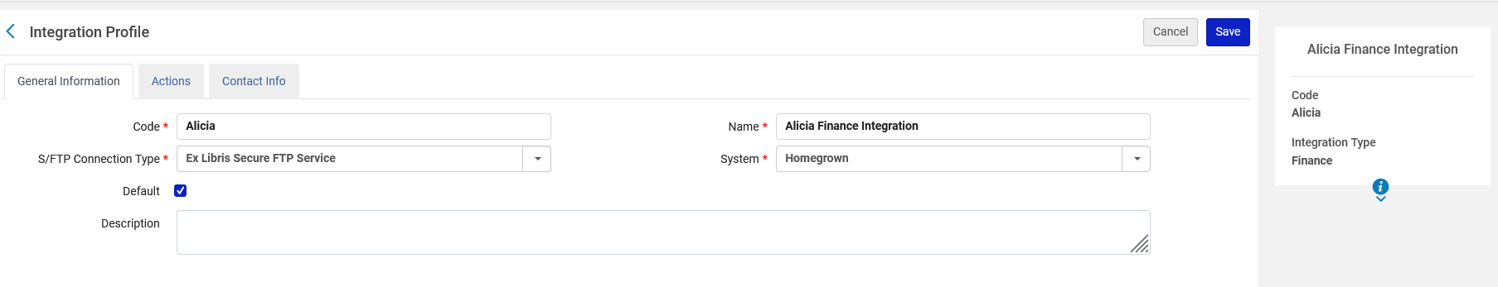
The integration profile
Here in the “General Information” tab the integration type and the ftp connection is chosen.

Slide 14
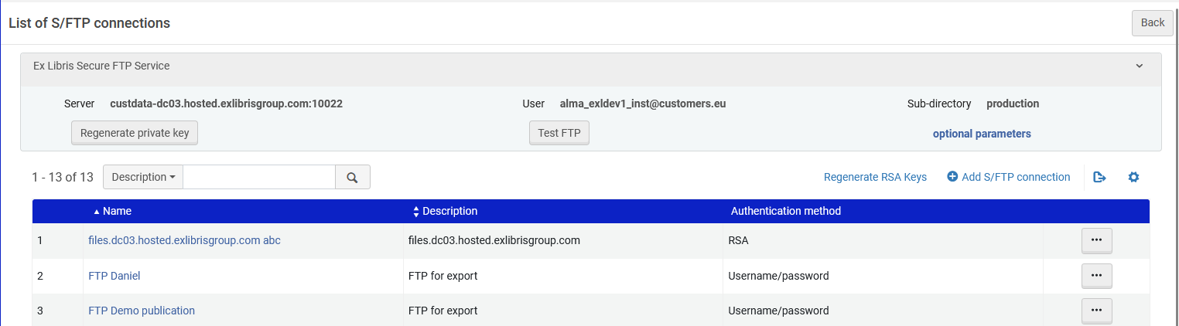
The integration profile
The ftp connection which is chosen in the “General Information” tab is defined under “External systems > S/FTP Connections” under the General Configuration menu.

Slide 15
The integration profile
As we will see in the next slide ….
In the integration profile “Actions” tab we have defined that:
The “Import Payment Confirmation” will occur every day at 02:00 and will go to directory “importinvoice” on the ftp server.
The “Export Invoices for Payment” will occur every day at 02:00 and will go to directory “exportinvoice” on the ftp server.
Note that the import and export can also be run manually.

Slide 16
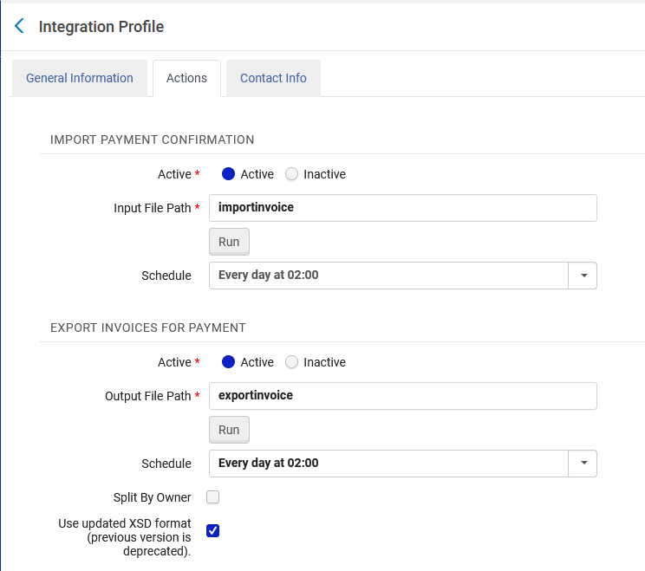
The integration profile

Slide 17
The invoice is created and ready to be paid

Slide 18
The invoice is created and ready to be paid
The invoice gets created via one of the methods described here.
In our example we will manually create an invoice for PO-750713 (which has one order, POL-47066, with title “An analysis of recreational sport programs for boys and girls in ages 12 to 14 in Taoyuan City, Taiwan”).
The invoice “Payment method” is “Accounting Department”.
See here for information about making this the default method payment method. The next slide shows the invoice header.

Slide 19
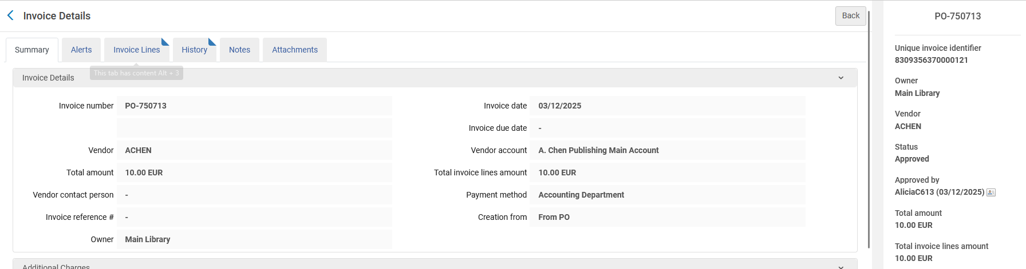
The invoice is created and ready to be paid
The invoice header

Slide 20
The invoice is created and ready to be paid
Note that the invoice is in status “Approved”. There is an optional step to first make it need to be approved before the invoice is “Ready to be Paid”. This is dependent on the Invoice Approval Rules. See here for more about these rules.

Slide 21
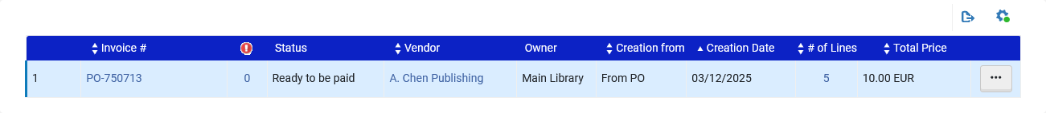
The invoice is created and ready to be paid
The invoice is in status “Ready to be paid”

Slide 22
Invoice is exported to the finance system

Slide 23
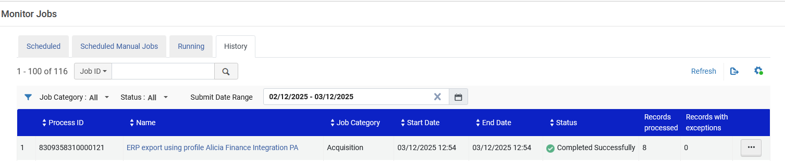
Invoice is exported to the finance system
Now the invoice will be exported. See here for more information.
The job “Export Invoices for Payment” is run as defined in the integration profile which we saw above.

Slide 24
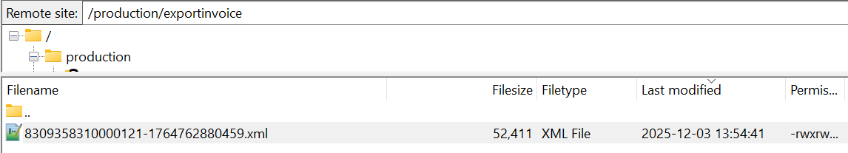
Invoice is exported to the finance system
The file of the invoice is then on the ftp server for the finance department to take.
In this case the file is called 8309358310000121-1764762880459.xml and you can see the actual file here.
See also the Data Dictionary (based on xsd) for the invoice export here.

Slide 25
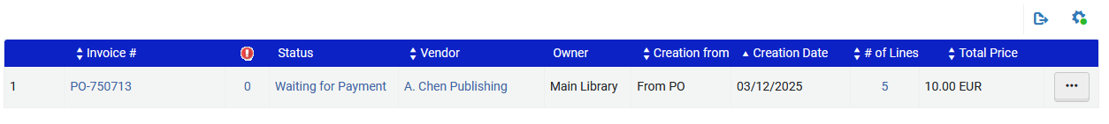
Invoice is exported to the finance system
Because the job “Export Invoices for Payment” has run the invoice changes status from “Ready to be paid” to status “Waiting for Payment”

Slide 26
Payment status imported from Finance System invoice closed

Slide 27
Payment status imported from Finance System invoice closed
Now the invoice information is imported from the finance system. See here for more information about the invoice import.
The Finance system has paid the invoice and returns an xml file back to the defined directory on the ftp server with the payment status PAID.

Slide 28
Payment status imported from Finance System invoice closed
The important tag in the xml is this:
<xb:payment_status>PAID</xb:payment_status>
If the invoice is rejected by the finance department then the invoice xml should have this:
<xb:payment_status>REJECTED</xb:payment_status>
The xml should also have the unique identifier of the invoice. It was included also in the export.

Slide 29

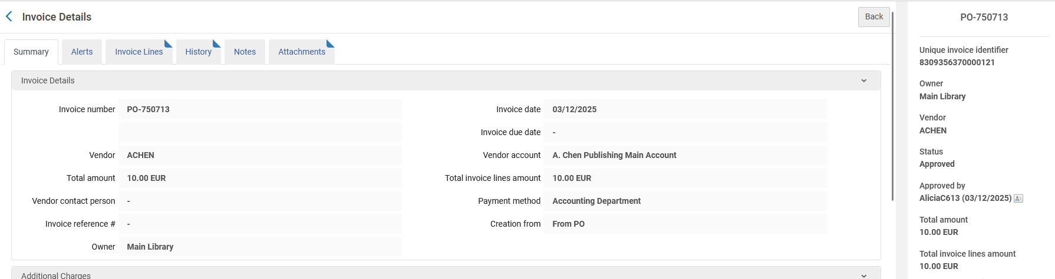
Payment status imported from Finance System invoice closed
Here is the unique identifier of the invoice from the export.
Here is the unique identifier of the invoice in the UI.

Slide 30
Payment status imported from Finance System invoice closed
The invoice information in xml format is put on the ftp server by the finance system.
The file is called 8309358310000121-1764762880459-import-approval.xml and you can see the actual file here (or on next slide)
See also the Data Dictionary (based on xsd) for the invoice import here.

Slide 31
Payment status imported from Finance System invoice closed
<?xml version="1.0" encoding="UTF-8"?>
<xb:payment_confirmation_data xmlns:xb="http://com/exlibris/repository/acq/xmlbeans">
<xb:invoice_list>
<xb:invoice>
<xb:vendor_code>ACHEN</xb:vendor_code>
<xb:invoice_number>PO-750713</xb:invoice_number>
<xb:unique_identifier>8309356370000121</xb:unique_identifier>
<xb:payment_status>PAID</xb:payment_status>
<xb:payment_note>Paid and approved by Thomas Safransky</xb:payment_note>
<xb:invoice_date>20251203</xb:invoice_date>
<xb:payment_voucher_date>20251203</xb:payment_voucher_date>
<xb:payment_voucher_number> 613 </xb:payment_voucher_number>
<xb:voucher_amount>
<xb:currency>EUR</xb:currency>
<xb:sum>10.00</xb:sum>
</xb:voucher_amount>
</xb:invoice>
</xb:invoice_list>
</xb:payment_confirmation_data>
If you copy and paste this, make sure the quotation marks in the first two lines do not get corrupted in the paste

Slide 32
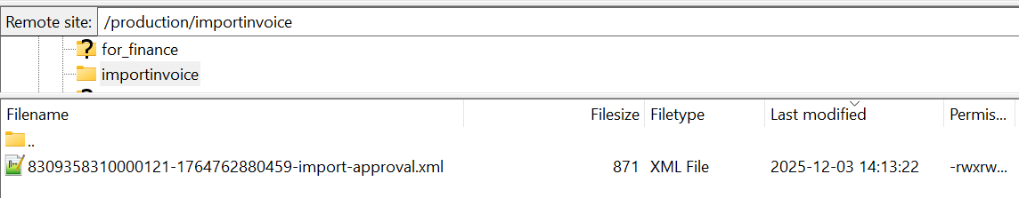
Payment status imported from Finance System invoice closed
The file is on the ftp server in the directory specified as the input file path for the “import payment confirmation” in the actions tab of the integration profile.

Slide 33
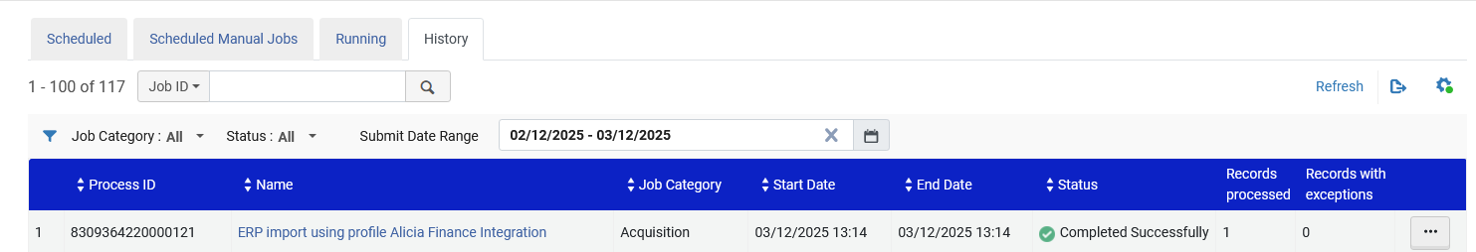
Payment status imported from Finance System invoice closed
The job “Import Payment Confirmation” is run as defined in the integration profile.

Slide 34
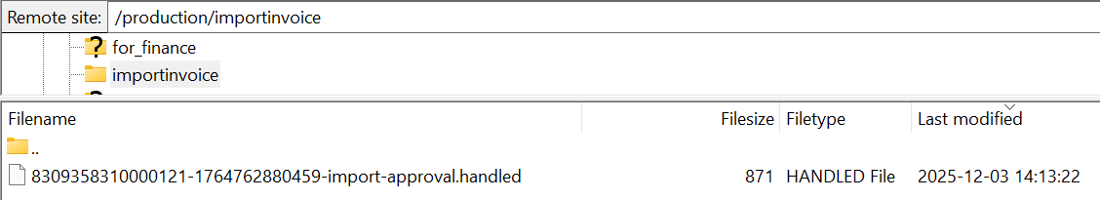
Payment status imported from Finance System invoice closed
On the ftp server the file gets a suffix “handled” to indicate that it has been handled and the job will not take it again next time it runs.

Slide 35
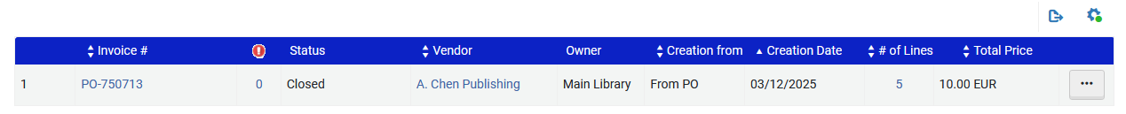
Payment status imported from Finance System invoice closed
The invoice changes to status “Closed”:

